Slide 1
Serial vs Parallel Algorithm
By: Rubisha Pokhrel

Slide 2
Introduction to Algorithm
Step-wise representation of a solution to a given problem.
Algorithm design depends upon architecture of computer.
According to architecture of computer, there are two type of algorithm:
1.Serial or Sequential Algorithm
2.Parallel Algorithm

Slide 3
Introduction to Serial Algorithm
This process involves developing content sequentially, one step at a time.
Intuitive and easy to understand
Serial processing
Dependent steps

Slide 4

Characteristics of Serial Algorithm
Pp1.Sequential Execution
3.Simplicity
as2.2.Determinastic
4.Limited performance

Slide 5
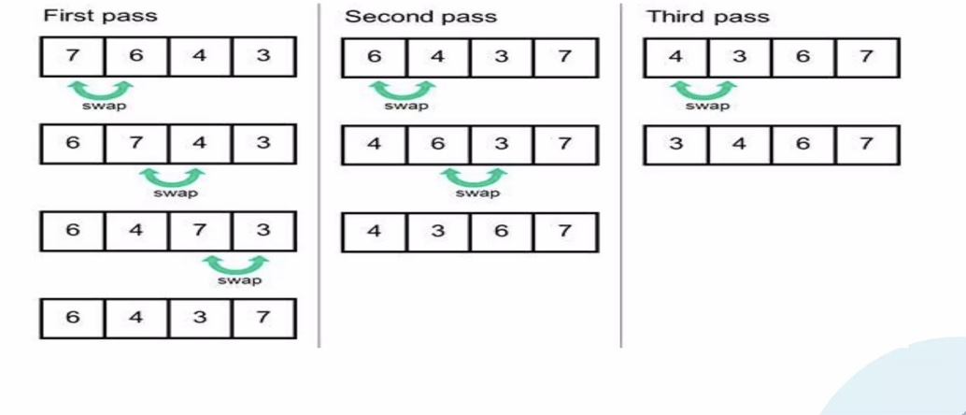
Example of Serial Algorithm

Slide 6
Introduction to Parallel Algorithm
Parallel processing involves developing multiple pieces of content simultaneously,
Distributing a larger task into small number of independent task and then solve them using multiple processing elements simultaneously,
Data Dependency,
Individual outputs combined-Desired output.

Slide 7
Characteristics of Parallel Algorithm
Pp1.Parallel Execution
3.Complexity
as2.2.Non-Determinastic
4.Improved performance

Slide 8
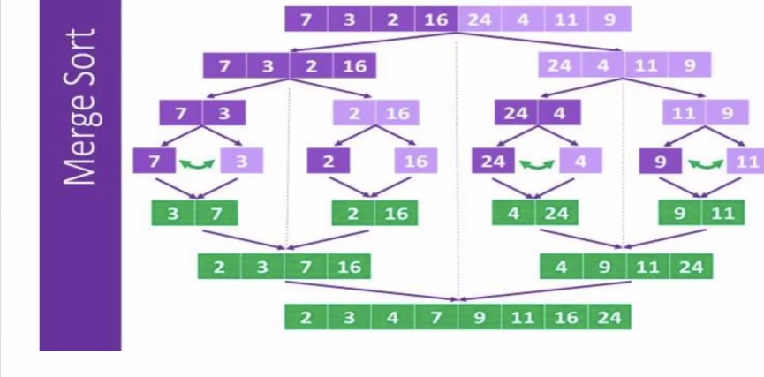
Example of Parallel Algorithm
Step 1:
Split sub-list in two until you reach pair of value.
Step 2:
Sort/swap pair of value if needed.
Step 3:
Merge and sort sub-list and repeat the process till you merge to the full list.

Slide 9
Serial vs Parallel Algorithm
Serial Algorithm | Parallel Algorithm
1.Steps are performed one another. | 1.Steps are performed simultaneously.
2.Simpler to design and implement. | 2. Can be more complex to design.
3.Requires minimum hardware resources. | 3.Requires more hardware resources.
4.Can underutilize available resources. | 4.Can fully utilize available resources.
5.Less fault tolerant. | 5.More fault tolerant.
6.Suitable for small task. | 6.Suitable for complicated task.
7.Example :Bubble sort ,Linear search. | 7.Example: Matrix multiplications, image processing ,scientific simulations.

Slide 10



Application of Serial Algorithm
Finance
Analyze market trends and make predictions.
Manufacturing
Optimize production processes and reduce errors
Healthcare
Analyze patient data and treatment outcomes.

Slide 11
Application of Parallel Algorithm
1. Scientific Simulations:
Simulations study complex phenomena that are hard or costly to replicate physically.
2. Data Analytics and Big Data:
These involve handling and analyzing data, not data structures themselves.
3. Image and Video Processing:
Manipulating and enhancing visual data in computer science.
4. Numerical Simulations:
Solving mathematical models with computer algorithms.
5. Network Routing and Graph Algorithms:
Parallel algorithms optimize network tasks and solve graph problems like shortest path efficiently.

Slide 12


